Slide 1
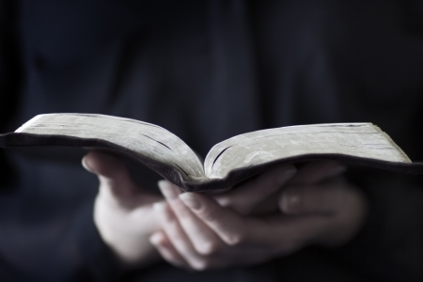
Psalm 1

Slide 2
“How blessed is the man who does not walk in the counsel of the wicked, Nor stand in the path of sinners, Nor sit in the seat of scoffers!”
Where might this kind of counsel come from? (The pictures offer some clues)

Slide 3
Give some examples of “the counsel of the wicked.”
What three actions are we told in Psalm 1:1 not to do if we want our life to be blessed (happy)? Notice the gradual progression down this path (walking, standing, then sitting).
What does God call Lot in 2 Peter 2:7-9? Notice his gradual departure from God and His ways as he progressed down the path which Psalm 1:1 describes:
Gen. 13:1-11 ______________________________
Gen. 13:12-13 _____________________________
Gen. 14:12 ________________________________ Gen. 19:1 _________________________________
He saw what looked good to him
He set up his tents next to wicked Sodom
He moved into Sodom
He sat in Sodom’s gate as one of the influential
Read Genesis 19. What price did Lot pay for choosing to walk down the path that Psalm 1:1 warns us about?

Slide 4
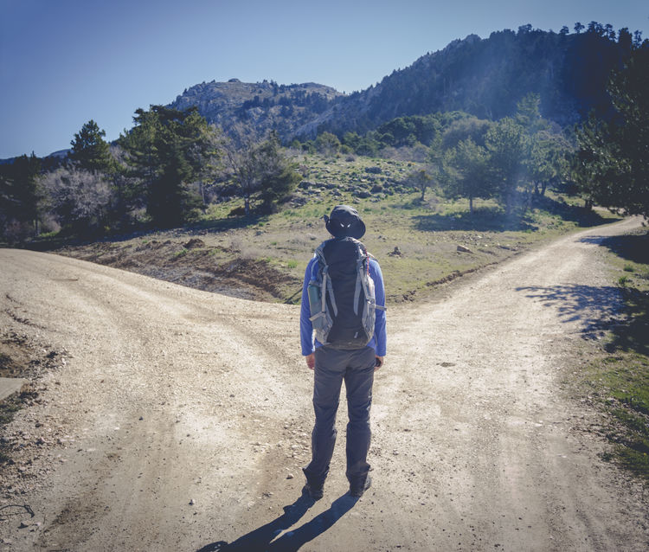
What good advice do these verses give us about how to stay off the path of the wicked?
Prov. 13:20
Prov. 1:10-16
Prov. 4:10-19
1 Cor. 15:33
Look at your own life. Are you anywhere along the path of the wicked (in thinking or in actions)? It’s not too late to change directions!

Slide 5
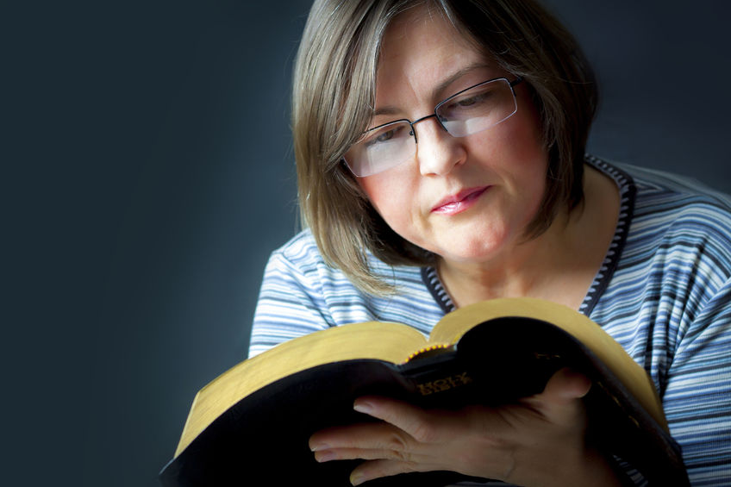
“But his delight is in the law of the Lord, And in His law he meditates day and night.”

Slide 6
According to Psalm 119, what are some of the benefits of being in God’s Word?
Keeps me from sin
Gives me counsel
Blessing
Strengthens me through grief
Verse 2
Verse 11
Verse 24
Verse 28
Revives me in affliction
Makes me wiser than my enemies
Gives me great insight
Gives me under-standing
Verse 50
Verse 98
Verse 99
Verse 100
Gives me great peace
Brings me delight when in anguish
Helps me detect/hate false ways
Guides me through life
Verse 165
Verse 105
Verse 143
Verse 104

Slide 7
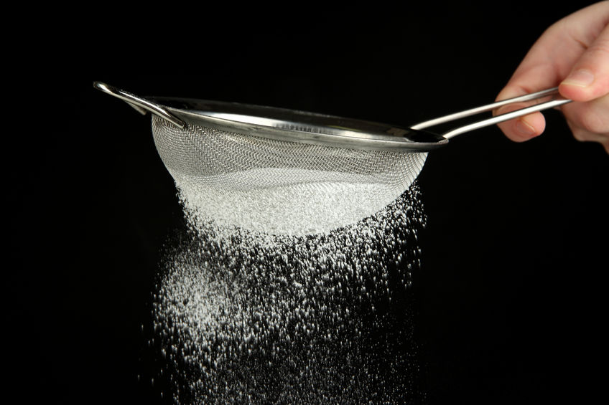
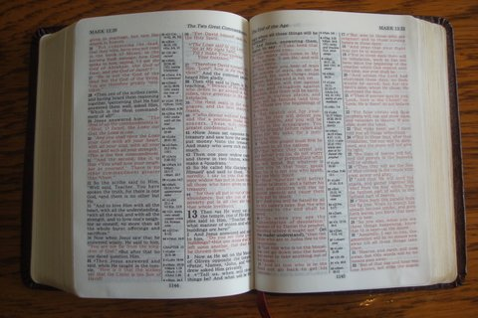
Culture
Beliefs
Advice
Attitudes
Responses
Feelings
When and where is your daily time in God’s Word?
Romans 12:2; Acts 17:11

Slide 8
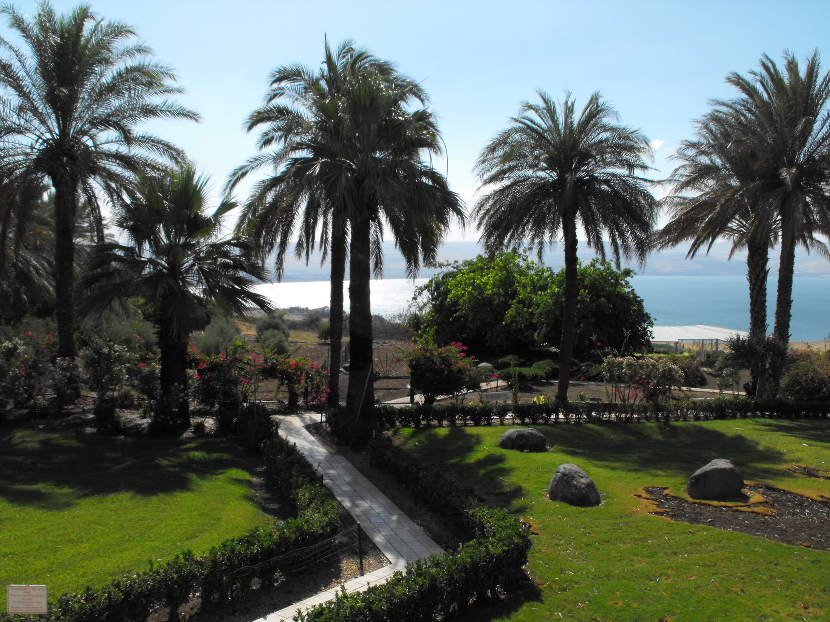
“And he will be like a tree firmly planted by streams of water,”

Slide 9
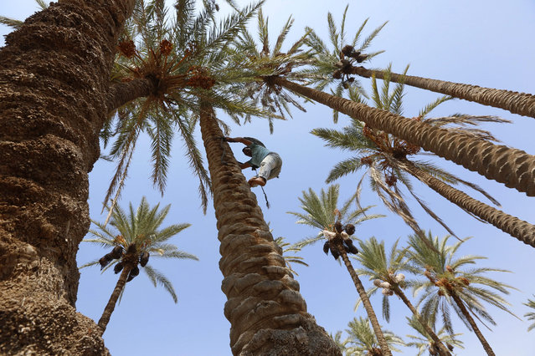
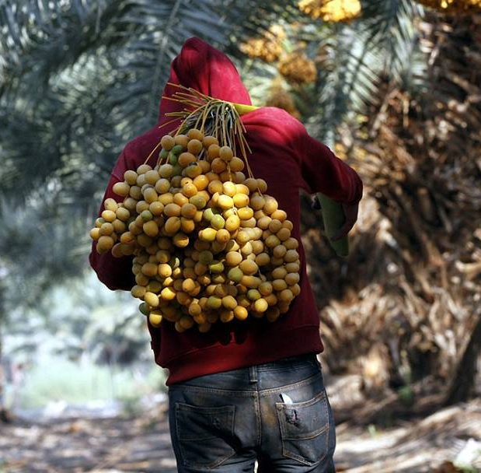
“Which yields its fruit in its season,”

Slide 10
What do these verses teach us about yielding fruit?
John 15:1-8
Galatians 5:22-23

Slide 11
Psalm 92:12-14
“And its leaf does not wither;
And in whatever he does, he prospers.”

Slide 12
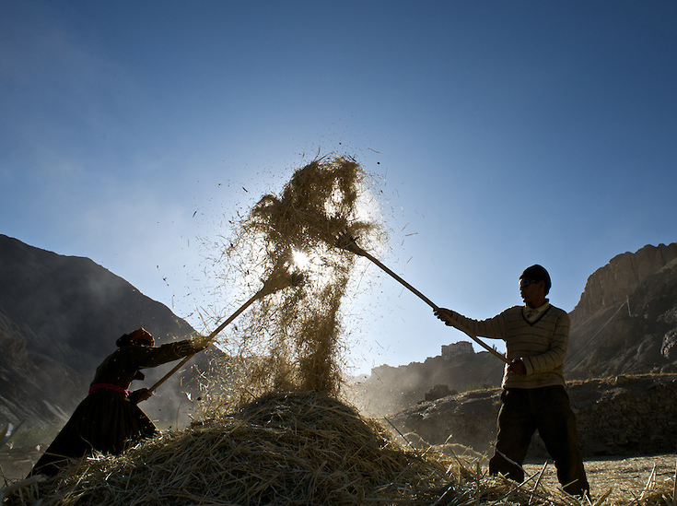
“The wicked are not so, But they are like chaff which the wind drives away.”

Slide 13
Rev.
20:11-15
“Therefore the wicked will not stand in the judgment, Nor sinners in the assembly of the righteous.”

Slide 14
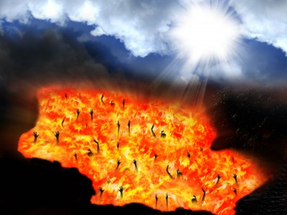
“For the Lord knows the way of the righteous, But the way of the wicked will perish”
John 3:14-18,36

Slide 15
We want to thank 123rf.com for their help in providing pictures for this presentation.

