Slide 1
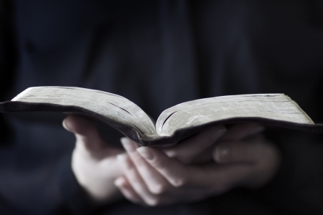
Isaiah 40:12-31

Slide 2
Pacific Ocean
“Who has measured the waters in the hollow of His hand,”
Atlantic Ocean
Indian Ocean
Arctic Ocean
Southern Ocean
Caribbean Sea
Gulf of Mexico
Bering Sea
Red Sea
Baltic Sea
East China Sea
Mediterranean Sea
Coral Sea
Caspian Sea
Black Sea

Slide 3
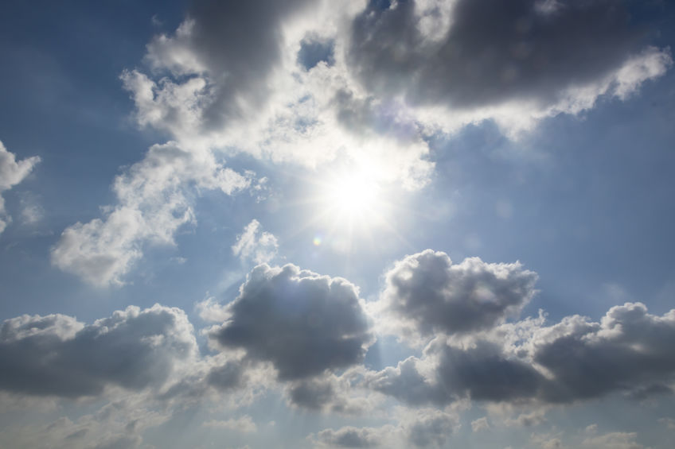
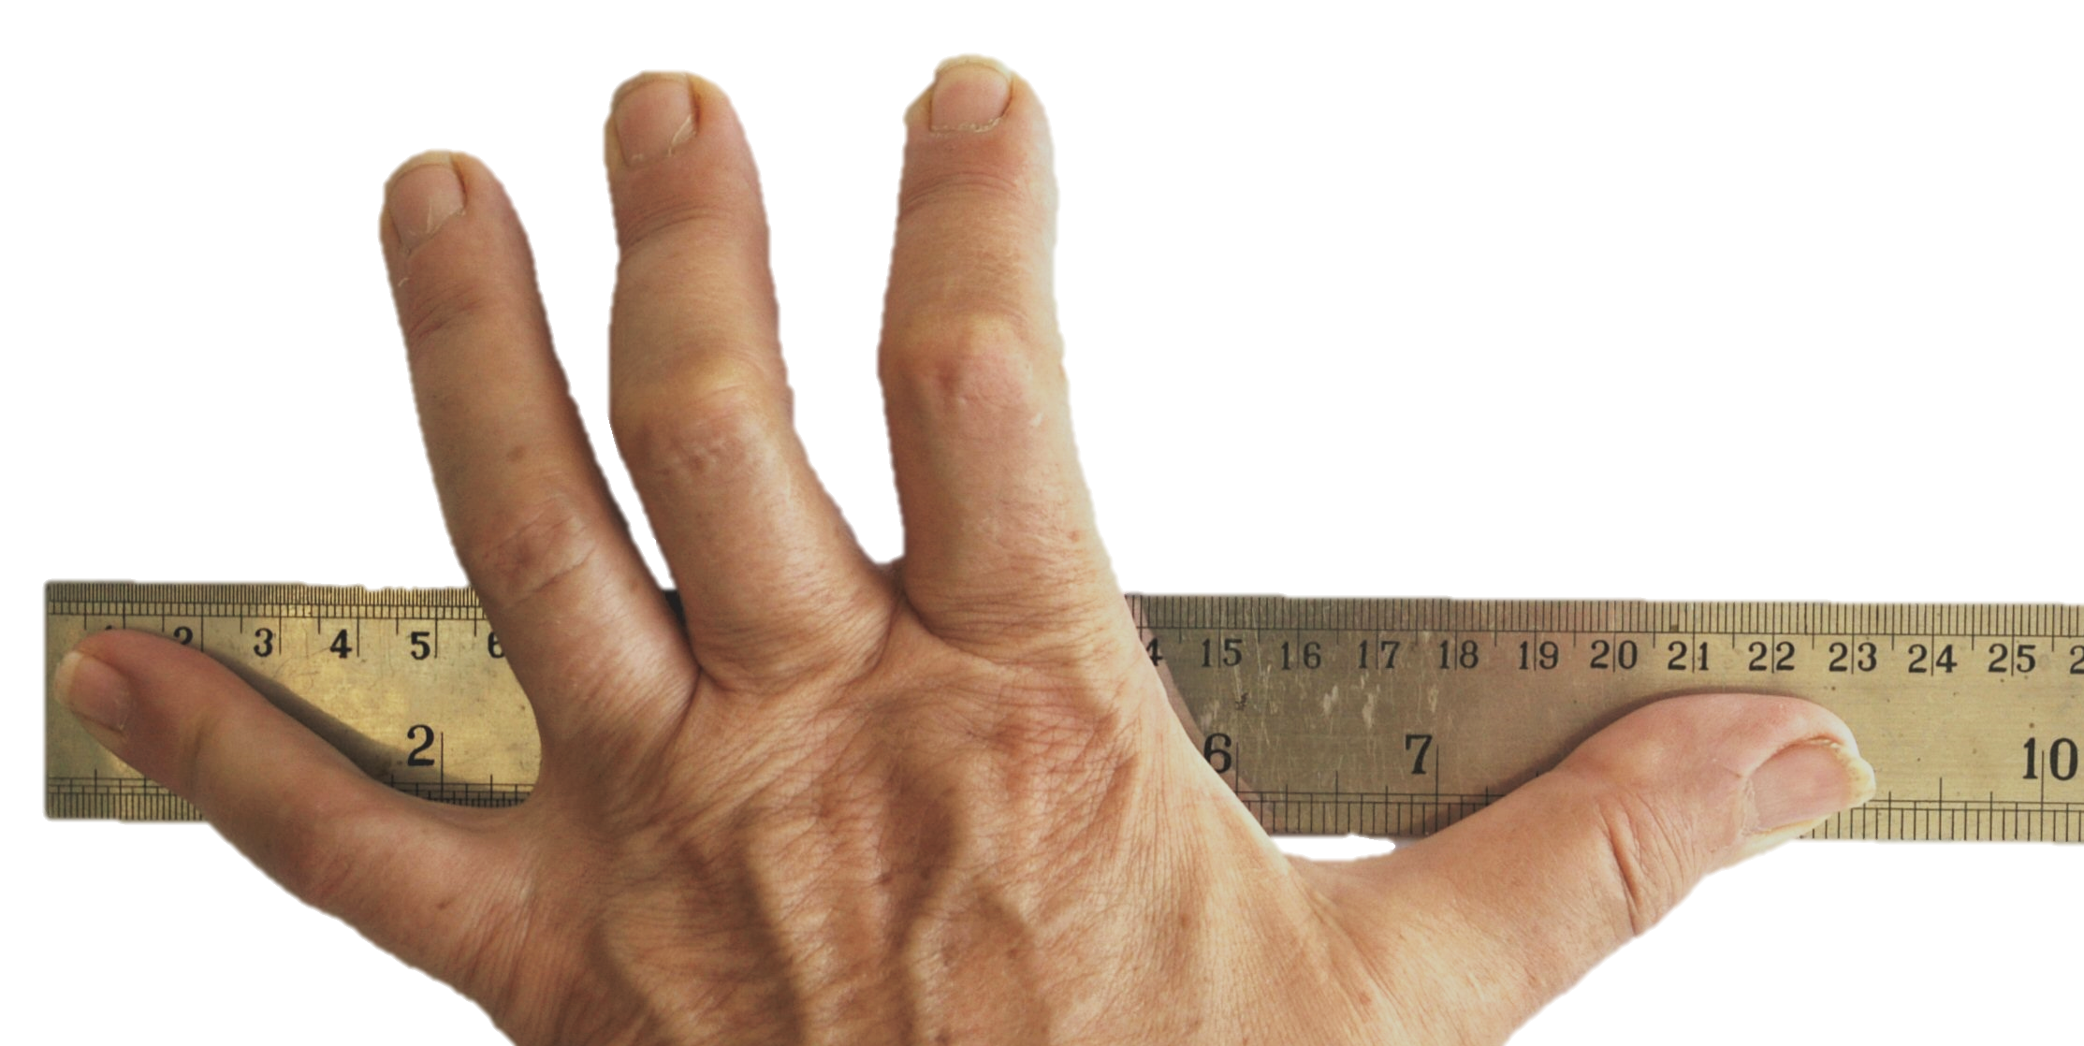
“And marked off the heavens by the span,”

Slide 4
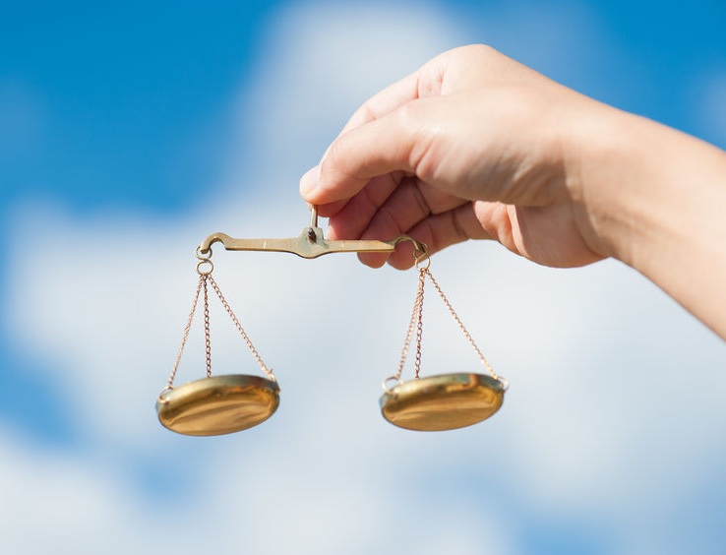
Mt. Everest
Rocky Mountains
The Alps
Mt. Fiji
Mt. Kilimanjaro
“And calculated the dust of the earth by the measure, and weighed the mountains in a balance, and the hills in a pair of scales?”

Slide 5
“Who has directed the Spirit of the Lord,
or as His counselor has informed Him? With whom did He consult and who gave Him understanding? And who taught Him in the path of justice and taught Him knowledge, and informed Him of the way of understanding?”

Slide 6
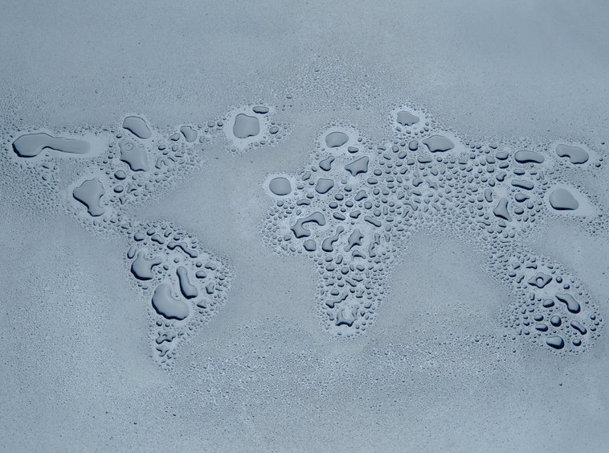
“Behold, the nations are like a drop from a bucket, and are regarded as a speck of dust on the scales; behold, He lifts up the islands like fine dust. Even Lebanon is not enough to burn, nor its beasts enough for a burnt offering. All the nations are as nothing before Him, they are regarded by Him as
less than nothing and meaningless.”
Contrast this with what He thinks of YOU! (Isaiah 40:11; Psalm 139:17-18)

Slide 7
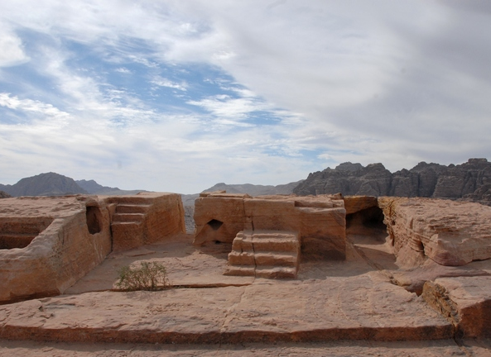
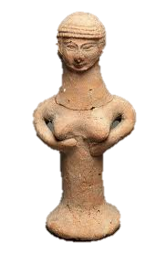
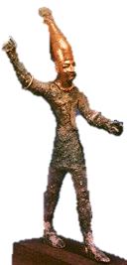
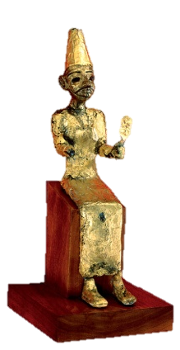
“To whom then will you liken God? Or what likeness will you compare with Him? As for the idol, a craftsman casts it, a goldsmith plates it with gold, and a silversmith fashions chains of silver. He who is too impoverished for such an offering selects a tree that does not rot; he seeks out for himself a skillful craftsman to prepare an idol that will not totter.”
Psalm 115:3-8
Deut. 12:30-31
Asherah (El’s wife; Baal’s mistress)
Jeremiah
2:11-13
Baal (El’s son)
El (Chief)
High place in Petra

Slide 8
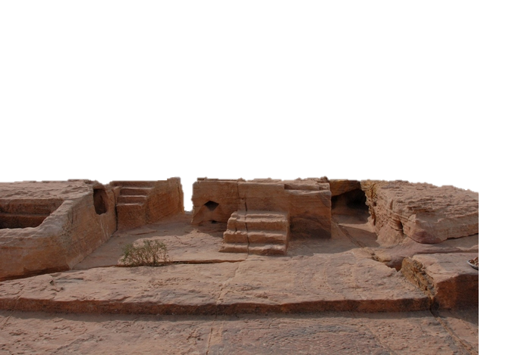
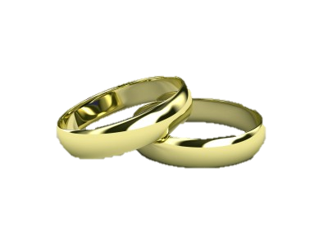
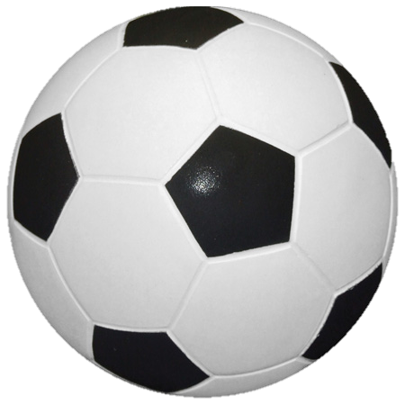
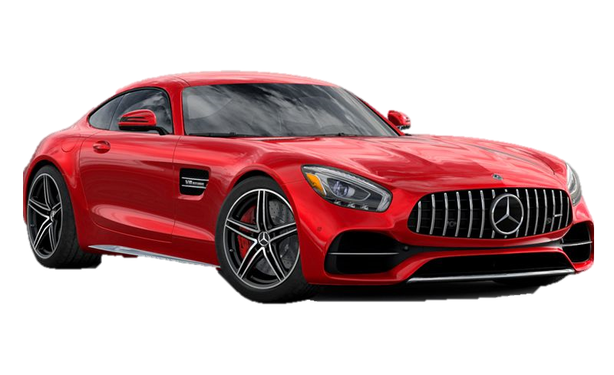
A Perfect Life
Beauty
Pleasure
Other Idols
House
Career
Marriage
Sports
Self
Stuff

Slide 9
“Do you not know? Have you not heard? Has it not been declared to you from the beginning?
Have you not understood
from the foundations of the earth?
It is He who sits above the vault of the earth, and its inhabitants are like grasshoppers,”

Slide 10
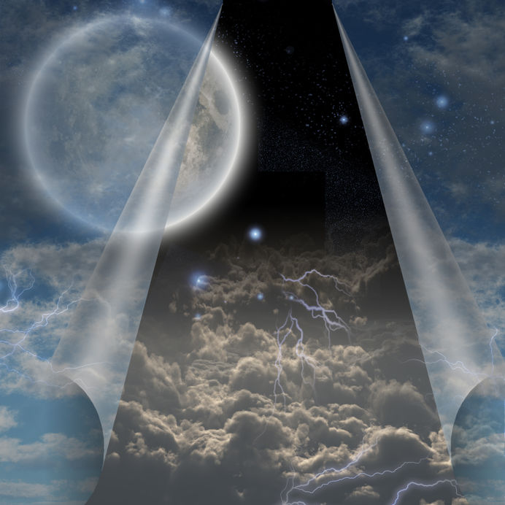
“Who stretches out the heavens like a curtain and spreads them out like a tent to dwell in.”

Slide 11
“He it is who reduces rulers to nothing,
Who makes the judges of the earth meaningless. Scarcely have they been planted, scarcely have they been sown, scarcely has their stock taken root in the earth, but He merely blows on them, and they wither, and the storm carries them away like stubble.”
Daniel 4:28-33
Acts 12:21-23

Slide 12
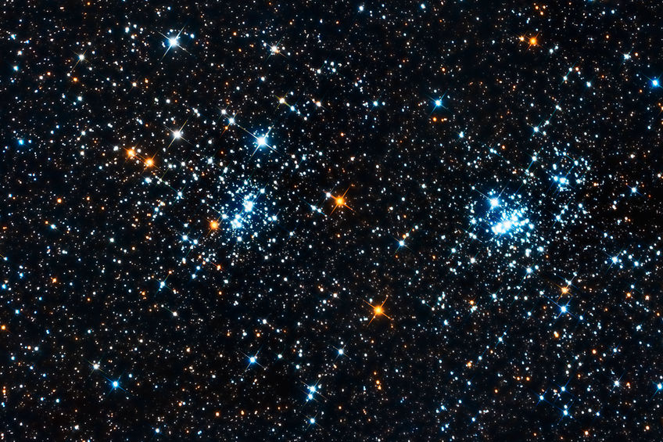
How many stars are there? Google it!
“‘To whom then will you liken Me
that I should be his equal?’ says the Holy One. Lift up your eyes on high and see who has created these stars, the One who leads forth their host by number, He calls them all by name; because of the greatness of His might and the strength of His power not one of them is missing.”

Slide 13
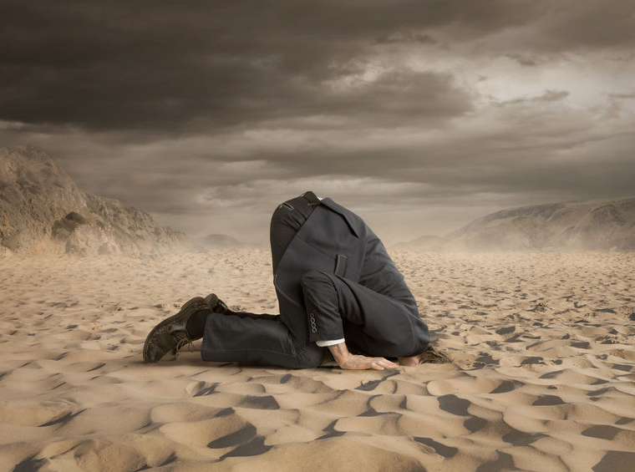
“Why do you say, O Jacob, and assert, O Israel,
‘My way is hidden from the Lord, and the justice due me escapes the notice of my God’? Do you not know? Have you not heard? The Everlasting God, the Lord, the Creator of the ends of the earth does not become weary or tired. His understanding is inscrutable.”

Slide 14
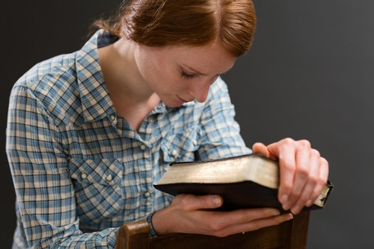
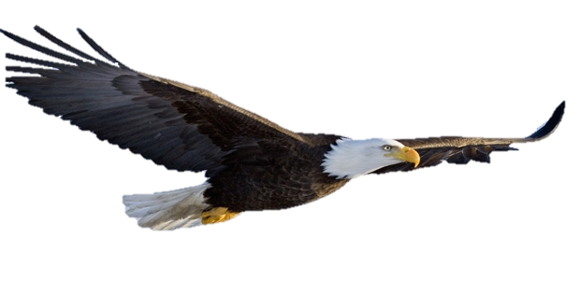
“He gives strength to the weary, and to him who lacks might He increases power. Though youths grow weary and tired, and vigorous young men stumble badly, yet those who wait for the Lord will gain new strength; they will mount up with wings like eagles, they will run and not get tired, they will walk and not become weary.”

Slide 15
We want to thank the following for their help in providing pictures for this presentation: 123rf.com

